Slide 1
Safe Driving Techniques
Taylor’s Special Care Services

Slide 2
Training objectives
Describe the importance of safe driving habits, particularly in transporting persons served
Describe how to control skids, drive in winter weather, and actions to take when stranded

Slide 3
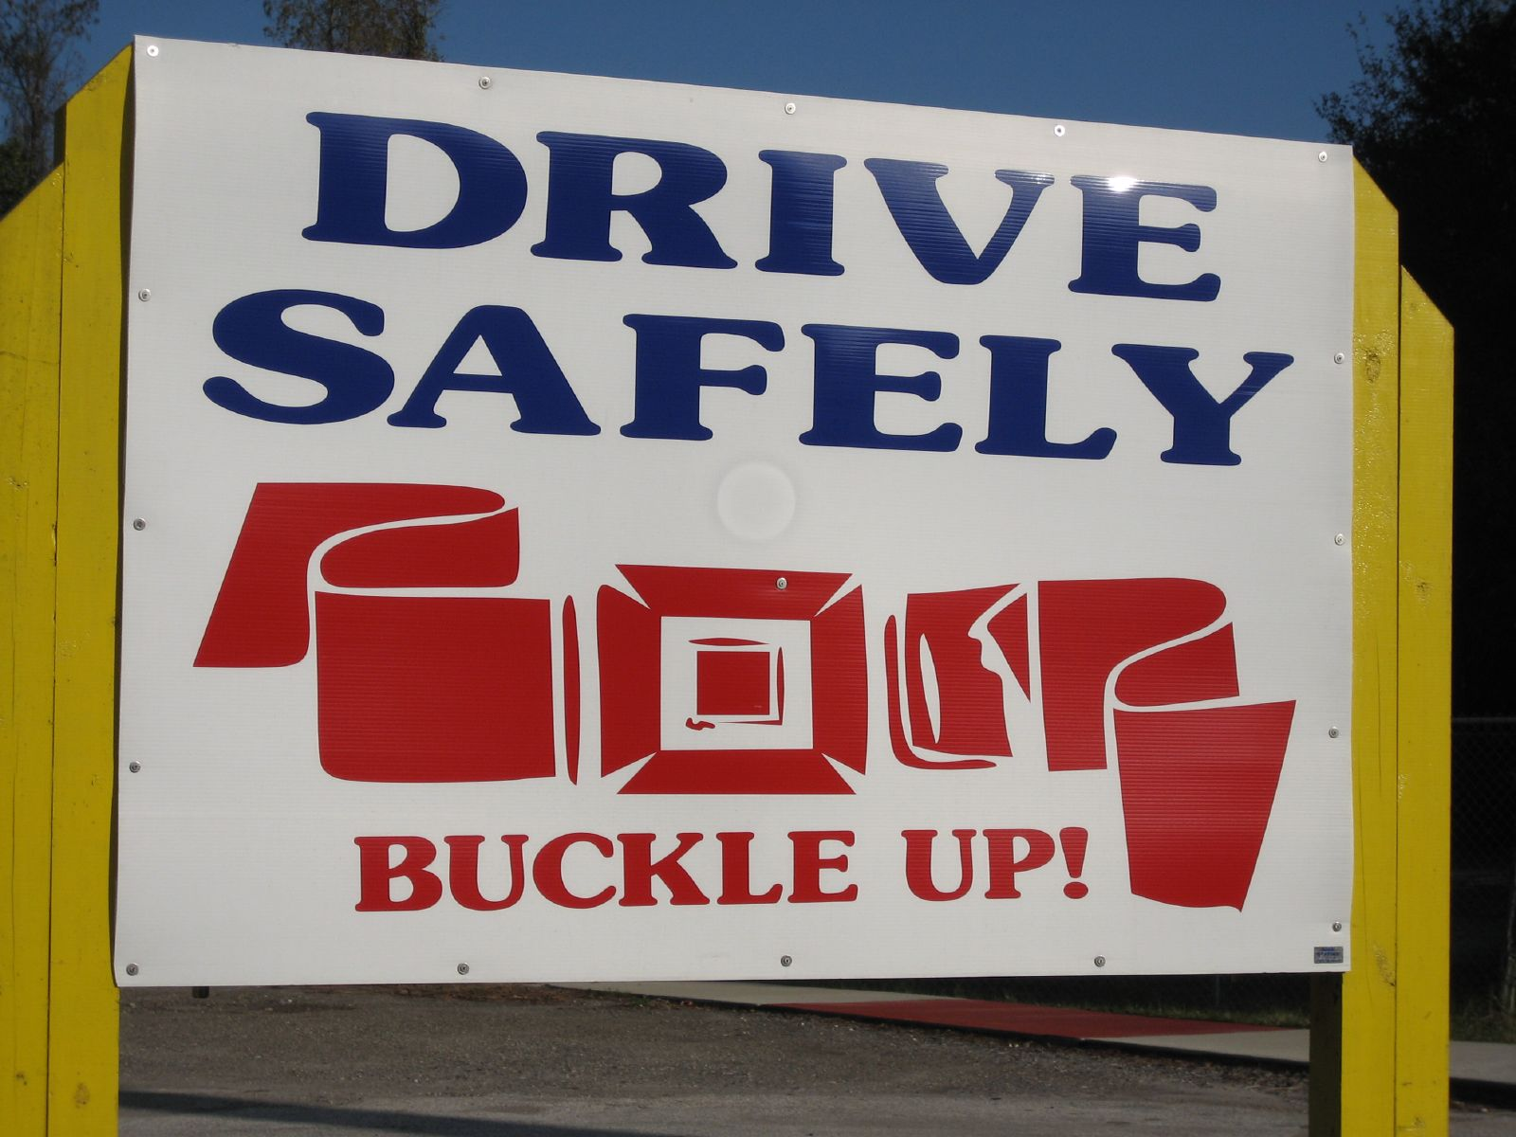
Note: all drivers are expected to obey the law while operating a vehicle…these are only safe driving techniques and not a comprehensive list of driving practices.
This Photo by Unknown Author is licensed under CC BY-SA

Slide 4
FYI…Safe Driving Suggestions
Fasten your seat belt. Make sure all passengers buckle up
Complete a pre-trip inspection prior to driving.
While driving, always look for an “out” – a place to steer if you ger in a difficult traffic situation
Before changing lanes, glance back to check the blind spot that you mirrors do not show
Drive at the posted speeds.
If something requires your immediate attention, pull over when it is safe

Slide 5
FYI…Safe Driving Suggestions….(Continued)
Anticipate stops and slowdowns
In slowing in fast traffic, tap brakes to flash taillights
Clean windshield and headlights when you stop for gas
Be courteous to other vehicles
Use your turn signals
Do not tailgate
Deer crossings signs are installed after several accidents in a stretch of road where deer are known to travel. Check the sides of the road

Slide 6
The faster you drive, the less reaction time you have

Slide 7
No texting and driving…it’s the law!!

Slide 8
Skid control
According to AAA Michigan, in 1990, 13% of the 387,180 vehicle crashed in <Michigan occurred on snow and ice-covered roads
To avoid skids, consider the following:
In winter, heavy use of the right lane of a multi-lane road may make it less slippery than the snow-covered pasting lane
If its “just sprinkling”, roads are more slippery than in a heavy rain
Be gentle with the brakes

