Slide 1
Taylor’s Special Care Services, Inc.
INTRO TO TSCS
WHAT WE ARE ALL ABOUT
TSCS
Taylor Special Care Services
housing ● staffing ● counseling ● on-going support
TSCS
Taylor’s Special Care Services
housing ● staffing ● counseling ● on-going support

Slide 2
INTRODUCTION - Agenda
About TSCS
Operating Capacity
Services
Performance Analysis
Documentation
Quiz
2

Slide 3
ABOUT TSCS
Began in 1999 by providing Adult Foster Care services
In 2004 business transformed to Housing & staffing support for (mainly) young adults then beginning in 2005 we served individuals between18 – 80 years of age.
Recipient of 101 Regional and National Best and Brightest Companies to Work For from 2013-present
TSCS has been accredited by CARF since 2007.
Next:
What is TSCS?
Mission / Vision / Values (Philosophy)
Organizational Chart
3

Slide 4
TSCS Mission / Vision / Values
4

Slide 5
TSCS Mission / Vision / Values
VISION STATEMENT 2025
By the year 2025, TSCS will be the one organization:
Recognized for the quality of our services by all people touched by our organization in the southeastern Michigan area.
Known for our quality performance in every aspect of our operations.
With the most committed, capable and giving staff and volunteers.
Known for our unified sense of purpose and our seamless network of services for people with mental illness and other special needs.
Consistently strengthening the public’s belief, commitment and financial support of our mission.
Consistently selected as the service provider of choice by people with mental illness or other special needs and those who refer or make decisions regarding service selection, such as, core providers.
Maintain CARF (Commission on Accreditation of Rehabilitation Facilities) accreditation to assure that our organization meets rigorous guidelines for services and quality, a national and international endorsement that our organization conforms to recognized service standards and is focused on delivering the most favorable results for consumers served.
5

Slide 6
ORGANIZATIONAL CHART/ INCIDENT COMMAND SYSTEM
Sherman Taylor Chief executive Officer
Chasity Ellis President / Chief Operating Officer
Stuart Grant Program Director
Priscilla Turner Director of Quality Assurance
Candace Richardson Office Administrator
Mallorie Starks Administrative Assistant
Dejana Hernandez Area Manager
Akeya Longmire Area Manager
Quania Atkins Home Manager Somerset Home
TBD Home Manager Lee Baker
Roxanne Turner Home Manager Winchester Home
William Shropshire Home Manager Thorndyke home
Keisha Franklin Home Manager Brandywynne Home
John Cleavenger Home Manager Bond Home
Asst Mgr/ Direct Care Workers
Asst Mgr/ Direct Care Workers
Asst Mgr/ Direct Care Workers
Asst Mgr/ Direct Care Workers
Asst Mgr/ Direct Care Workers
Asst Mgr/ Direct Care Workers
6

Slide 7
OPERATING CAPACITY
Specialized Residential/Community Housing
Seven Homes with over 30 beds
Over 30 clients and growing…
At least 8 facilities with over 10 thousand square ft.
Five licensed facilities…and growing...
More than 50 employees
Comprehensive benefits package includes for eligible employees, paid time off, holiday pay, sick leave, 401K plan, health, dental, vision and supplemental insurance coverage.
7

Slide 8
PROGRAMS and SERVICES
Group Home Care/Specialized Residential
Community Housing (CH)
Supported Living (SL)
- Personal Care (PC): are activities of daily living that require:
-- Physical assistance or
-- Doing the activity for the person.
Examples of personal care activities include, food preparation, feeding/eating, toileting, bathing, dressing, grooming, transferring, ambulation/mobility, taking medication/receiving treatment, laundry, household care.
8

Slide 9
PROGRAMS and SERVICES
- Community Living Supports (CLS): Person served,
Needs verbal direction, prompts, or guidance to complete an activity or
Needs to be reminded, supported, observed or monitored as they independently complete the activity, or
Has an IPS goal to increase their independence.
Needs Reminding/Observing/Training/Guiding with:
Meal preparation (with the person)
Laundry (with the person)
Routine Household Care/Maintenance (with the person)
Activities of Daily Living: teaching, providing verbal prompts, reminde guidance, or monitoring to teach the person any of these skills.
Shopping (with the person)
rs,
9

Slide 10
PROGRAMS and SERVICES
- Community Living Supports (CLS): Cont’d
Supporting/Training/Verbally Assisting with:
Money Management (with the person)
Socialization and Relationship Building (with the person)
Transportation to/from Community Activities (with the person)
Leisure Choices and Participation in Community Leisure Activities (with the person)
Attendance at Medical/Other Appointments (for the purpose of information gathering, sharing, assisting the individual in completing paperwork, etc.)
Non-Medical Care
Medication Administration Reminding/Observing/Monitoring
Monitoring/Supervision, Protection for:
Health and Safety (eyes-on)
Sleep Time

Slide 11
SERVICES
Aid with implementation of IPOS / PCP
Assist with transition to independence
Daily household skills Socialization
Job readiness preparation Financial management
Medication administration, monitoring and management
e.g.
Monitor and promote movement to lesser restrictive settings (i.e., SIPs)
Case management communication
Daily documentation

Slide 12
SERVICES - COUNSELING
Gentle Teaching techniques and approaches.
One-on-one discussions and assistance:
Developing mission statement and short term goals.
Achieving goals & IPOS/PCP’s including, school, job and personal interest.
Money management and budgeting.
Learn alternative ways of dealing with anger and offer active listening.

Slide 13
SERVICES - SUPPORTS
Implementation and monitoring of assessment plan/intake.
Assistance with personal are, community living supports, activity of daily living skills, etc.
Assistance with transportation needs.
Assistance in grocery shopping, diet planning and food preparation.
Adult activities and community integration.
Assistance in refining socialization skills.
Aid and assist with referrals to community resources, such as, legal issues, etc.

Slide 14
PERFORMANCE ANALYSIS
CARF Accreditation
Customer-Driven Outcomes Management System
Strategic Plan
Quality Improvement Plan & Program
Corporate Compliance Plan & Program
Safety, Health and Accessibility Plan & Program
Diversity Plan
Risk Management Plan
Technology Plan
Policies and Procedures Manual
Privacy & Security (Risk Analysis)
Plans and programs that spell out parameters and guidelines that employees must follow.

Slide 15
PERFORMANCE ANALYSIS
CARF Accreditation
Survey: Achieved 3-Yr Accreditation in Feb’13
Standards: ECS
Process: Flowchart
Customer-Driven Outcomes Management System
TSCS
Taylor Special Care Services
housing ● staffing ● counseling ● on-going support
TSCS
Process for Development and Implementation of Customer-Driven Outcomes Management Systems (CD-OMS) in TSCS Programs
C o rp o rate H e ad q
T S C S
T a y l o r S p e c i a l C a r e S e r v i c e s
h o u s in g ? s ta f f in g ? c o u n s e l in g ? o n - g o in g s u p p o r t
23 80 0 W . T e n M ile R d.,
T S C S
T a y l o r S p e c i a l C a r e S e r v i c e s
h o u s in g ? s ta f f in g ? c o u n s e l in g ? o n - g o in g s u p p o r t
S o u th fie ld , M P h: 24 8 -3
F ax : 248 -3
Taylor Special Care Services
housing ● staffing ● counseling ● on-going support
Introduction and Orientation on CD-OMS to TSCS Home Managers and Staff
Programs/Homes Convene CD-OMS Teams
(3)
Identify Stakeholders and Define Outcomes Expectations
(1)
Perform Business Analysis
SWOT
(2)
Identify and Select
Outcomes
CD-OMS Team List
SWOT
Reports
Outcomes Reports
Stakeholders and Outcomes Lists
Measurable Outcomes: Administrative & Programmatic
(Effectiveness, Efficiency, Service Access, Client Satisfaction, Stakeholder Satisfaction)
Based on staff’s goals & objectives
Based on residents’ goals & objectives
(8)
Obtain Consumer Characteristics Data
(7)
Obtain Follow-Up Information
(6)
Obtain Individual Stakeholder Satisfaction Information
(5)
Obtain Individual Client Satisfaction Information
(4)
Design Outcomes System
Consumer Characteristics Report
Satisfaction Measure Instrument and Results
Satisfaction Measure Instrument and Results
Outcome System Plan
(9)
Using Results to Continually Improve Services
(10)
Share Outcomes Information (QI Report Card for Consumers, Stakeholders and Staff)
Continuous Process Improvement
CD-OMS Proc Requires
Documentatio of Activities
(i.e., Book wi Activities Note
Consumer Advisory Council (CAC)
Various advocacy workgroups

Slide 16
PERFORMANCE ANALYSIS
QI Plan & Program
Outcomes (departments and programs)
Satisfaction surveys questionn
Staff Qualifications & Training
Quality Improvement
Consumer Involvement (CAC)
Performance Improvement Pro
Utilization Management (Review)
Corporate Compliance
Etc.
aires
jects

Slide 17
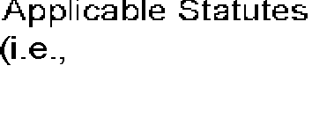
PERFORMANCE ANALYSIS
Corporate Compliance Plan & Program
TSCS
Taylor Special Care Services
housing ● staffing ● counseling ● on-going support
TSCS
TSCS
Taylor Special Care Services
housing ● staffing ● counseling ● on-going support
TSCS
Taylor Special Care Services
housing ● staffing ● counseling ● on-going support
Taylor Special Care Services
housing ● staffing ● counseling ● on-going support

Slide 18
PERFORMANCE ANALYSIS
Safety, Health and Accessibility Plan & Program
SH&A Teams
Training & Education
SH&A Policies and Procedures including but not limited to:
Internal/External Facility Inspections
Accessibility Surveys
Vehicle Inspections
Emergency Drills/Planning
Evacuation Plans
TSCS
Taylor Special Care Services
housing ● staffing ● counseling ● on-going support
TSCS
Taylor Special Care Services
housing ● staffing ● counseling ● on-going support

Slide 19
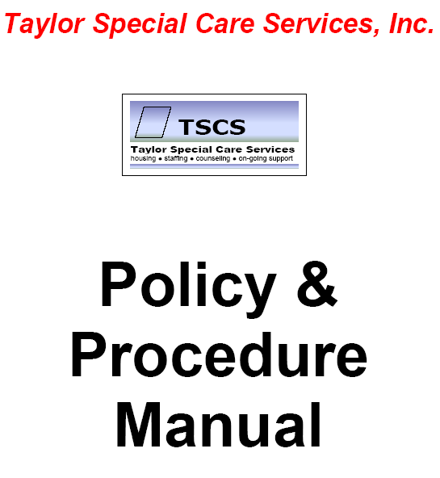
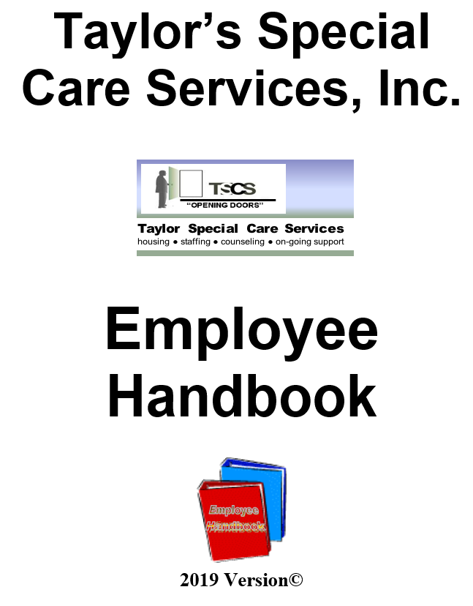
PERFORMANCE ANALYSIS
Look for and read these manuals:
Policies and Procedures Manual
Business Practices
Leadership
Human Resources
Right of Persons Served
SH&A
Privacy & Security
Information Systems
Corporate Compliance
Financial Management
Programs & Services
Quality of Individualized Services
Adult Specialized Residential and Supported Independent Programs
Employee Handbook
TSCS
Taylor Special Care Services
housing ● staffing ● counseling ● on-going support
TSCS
Taylor Special Care Services
housing ● staffing ● counseling ● on-going support

Slide 20
PERFORMANCE ANALYSIS
Privacy & Security
Mental Health Code
HIPAA
Privacy Rule
Security Rule
Rights of Persons Served
Confidentiality Laws
Reminders – Staff meetings, ongoing education

Slide 21
DOCUMENTATION
Learn the following types of documentation:
Client Progress Logs (progress notes and hourly logs): GFIRP Model
Resident Charts
Personal Care Logs
Community Living Supports Log
Med Sheets/Logs & Med Records
Incident Reports (IR’s)
Communications Book
Case Manager/Visitor Book
LOA Form
Resident Telephone Log
Resident Money Logs
Annual mandated paperwork (i.e., assessments), etc.

Slide 22
Sample Quiz
TSCS MISSION is “to provide the highest-quality services and supports to people with chronic mental illness and residential young adults to meet their individual needs”.
True False
The following are examples of values that guide our actions:
We are always customer-focused.
We respect each other and all others.
We value integrity and conduct business ethically with a commitment to moral integrity.
None of the Above All of the Above
TSCS programs and services include “community housing” and “supported living”.
True False
TSCS is a CARF-accredited organization.
True False
TSCS has implemented policies, procedures, plans and programs that spell out parameters and guidelines employees must follow.
True False
Personal care activities require physical assistance or doing the activity for the person, while community living supports activities require reminding, observing, training, guiding, verbally assisting and monitoring the person served.
True False

